Slide 1


Presented by : Endah Rakhmawati
Chicago Taxi Trip
Data Series 10
Data Engineering

Slide 2
Dataset
bigquery-public-data.chicago_taxi_trips.taxi_trips

Slide 3
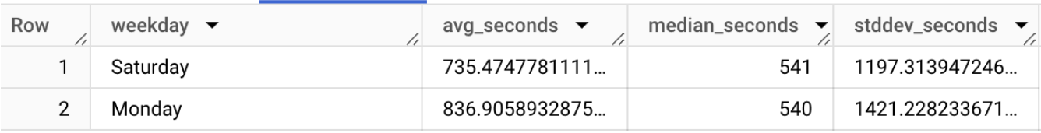
Task 1
Calculate the mean, median and standard deviation of trip duration (trip_seconds) for trips made on Mondays and Saturdays. Compare the two results that day.
Output :

Slide 4
Answer
WITH sat_mon_trip AS
(
SELECT
CASE
WHEN EXTRACT(DAYOFWEEK FROM trip_start_timestamp)=7 THEN 'Saturday'
WHEN EXTRACT(DAYOFWEEK FROM trip_start_timestamp)=2 THEN 'Monday'
ELSE 'others'
END weekday
,trip_seconds
,COUNT(unique_key) count_trip
FROM `bigquery-public-data.chicago_taxi_trips.taxi_trips`
where EXTRACT(DAYOFWEEK FROM trip_start_timestamp) in (2,7)
GROUP BY trip_start_timestamp,trip_seconds
LIMIT 10
),

Slide 5
Answer
med_seconds AS
(
SELECT x.weekday
,CASE WHEN COUNT(x.trip_seconds)>1 THEN SUM(x.trip_seconds)/2 ELSE SUM(x.trip_seconds)/1 END median_seconds
FROM
(
SELECT *
,ROW_NUMBER() OVER(PARTITION BY weekday ORDER BY trip_seconds) AS sort_trip_scnds
,CAST(COUNT(weekday) OVER(PARTITION BY weekday) AS DECIMAL) AS total_weekday
FROM sat_mon_trip
) x
WHERE x.sort_trip_scnds>=x.total_weekday/2 AND x.sort_trip_scnds<=(x.total_weekday/2)+1
GROUP BY x.weekday
--ORDER BY x.weekday
)
SELECT trip.weekday,SUM(trip.trip_seconds)/SUM(trip.count_trip) AS avg_seconds
,med.median_seconds,STDDEV(trip.trip_seconds) AS stddev_seconds
FROM sat_mon_trip trip
JOIN med_seconds med on med.weekday=trip.weekday
GROUP BY trip.weekday, med.median_seconds

Slide 6
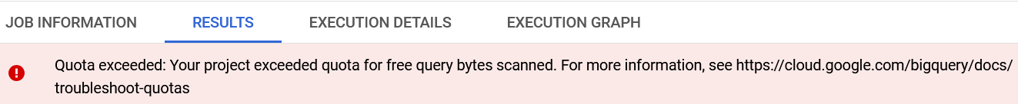
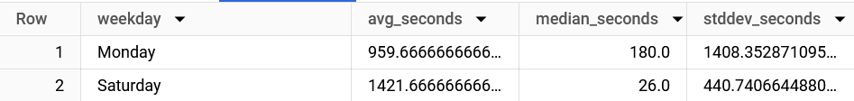
Answer
Error without LIMIT :
Output LIMIT 10 :

Slide 7
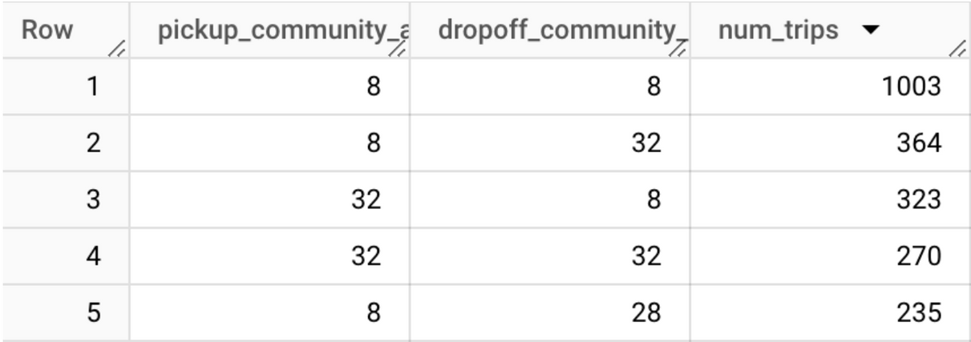
Task 2
Find five routes (from initial community_area to destination community_area) with the largest number of trips in 2023.
Output :

Slide 8
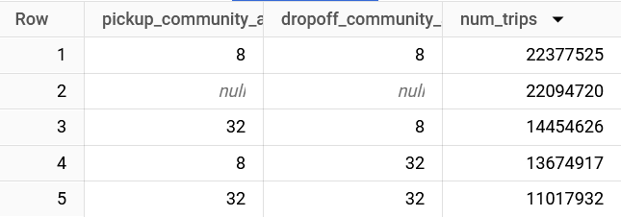
Answer
SELECT pickup_community_area,dropoff_community_area,COUNT(unique_key) AS num_trips
from `bigquery-public-data.chicago_taxi_trips.taxi_trips`
GROUP BY pickup_community_area,dropoff_community_area
ORDER BY num_trips DESC
LIMIT 5

Slide 9
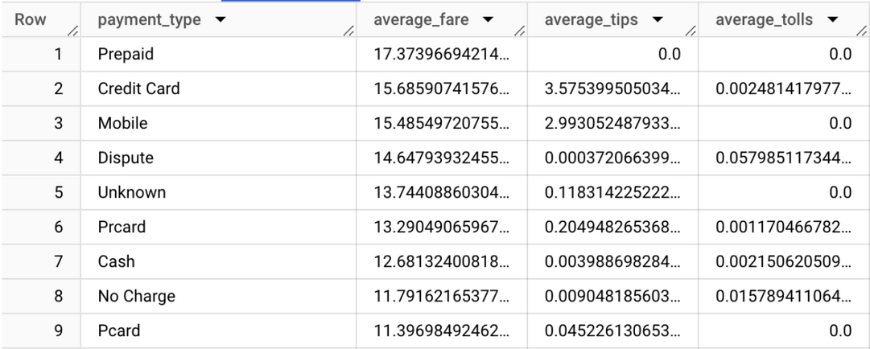
Task 3
Compare the average cost of a taxi trip (fare, tips, and taxes) based on payment methods in 2019.
Output :

Slide 10
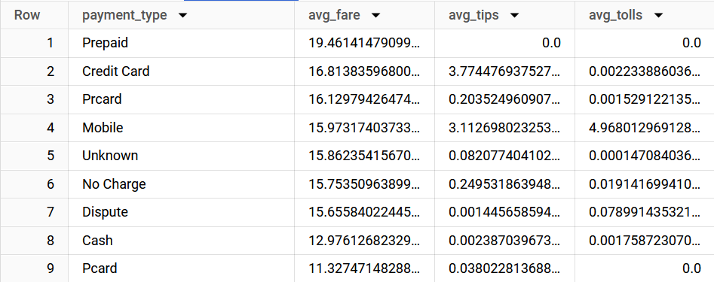
Answer
WITH summary_payment AS (
SELECT payment_type,count(unique_key) AS total_transact,SUM(fare) AS total_fare,SUM(tips) AS total_tips,SUM(tolls) AS total_tolls
from `bigquery-public-data.chicago_taxi_trips.taxi_trips`
where EXTRACT(YEAR FROM trip_start_timestamp)=2019
GROUP BY payment_type
)
SELECT payment_type,
SUM(total_fare)/SUM(total_transact) AS avg_fare,
SUM(total_tips)/SUM(total_transact) AS avg_tips,
SUM(total_tolls)/SUM(total_transact) AS avg_tolls
FROM summary_payment
GROUP BY payment_type
ORDER BY avg_fare DESC

Slide 11
Thank You

